Slide 1
Categorizing High Risk Pedestrians Using LiDAR Sensor Data and Machine Learning to Support Vision Zero
Sruthi Ashraf
Sky Guo
Visalatchi Palaniappan

Slide 2
Pedestrians have __?__ % of chance surviving when getting hit by a vehicle with a speed at 25 mph.

Slide 3
Pedestrians have __50%__ of chance surviving when getting hit by a vehicle with a speed at 25 mph.

Slide 4
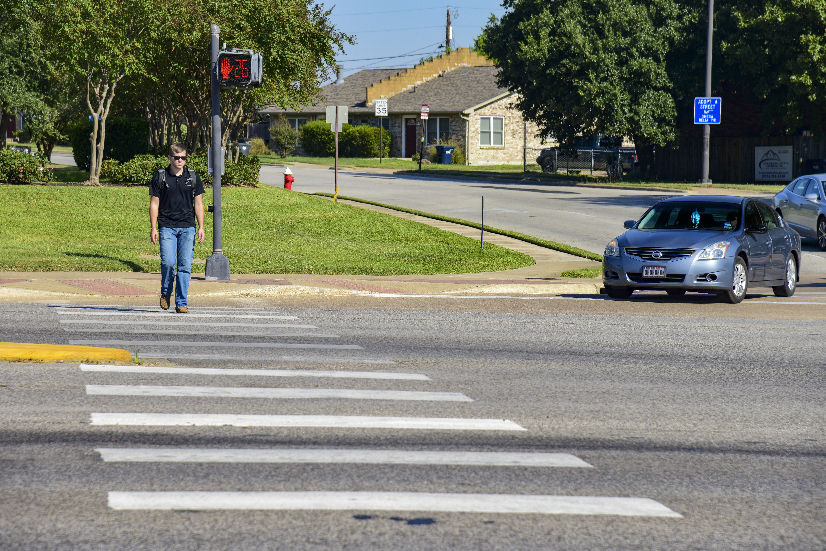
Who is Vulnerable Road User (VRU)?
VRUs are mainly those unprotected by an outside shield, namely pedestrians and two-wheelers, as they sustain a greater risk of injury in any collision against a vehicle and are therefore highly in need of protection against such collisions.
Safety of Vulnerable Road Users: DSTI/DOT/RTR/RS7(98)1/FINAL , International Road Research Documentation No. 895623, 1998. https://safety.fhwa.dot.gov/ped_bike/docs/oecd_safety.pdf

Slide 5
Motivation
About 2-3 pedestrians or bicyclists are involved in fatal crashes at signalized intersection per day (NHTSA)
Pedestrian phases are designed based on geometric design at intersection and an assumed walking speed
Certain VRUs are severely disadvantaged at crosswalks and intersections because they may have difficulty completing the crossing within the pre-programmed pedestrian phases
How can we account for different types of pedestrians?
How can we accommodate different walking speeds in pedestrian phases?
Notes:
Majority of existing study is focused on vehicle only, so it is lack of study on VRU: 1. is VRU different from vehicle only? 2. What are important factors contributed to VRU-involved conflict?

Slide 6
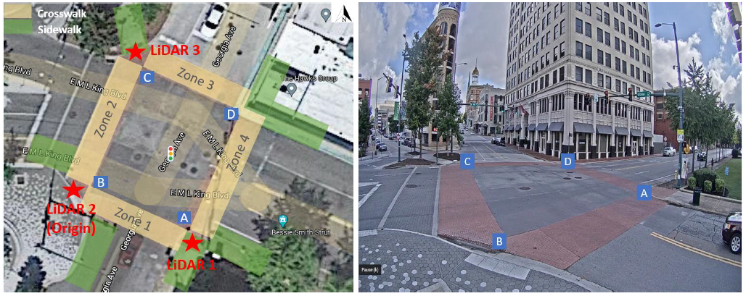
Leveraging LiDAR Data MLK and Georgia Ave in Chattanooga, TN
Timestamp
Type of object
Confidence of Tracking quality
Size of the object
Velocity
Position of object

Slide 7
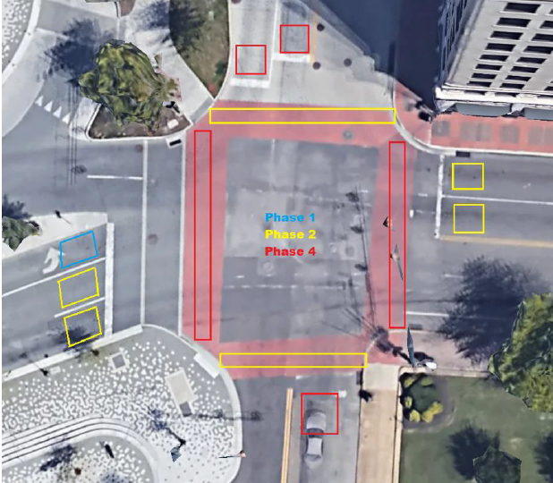
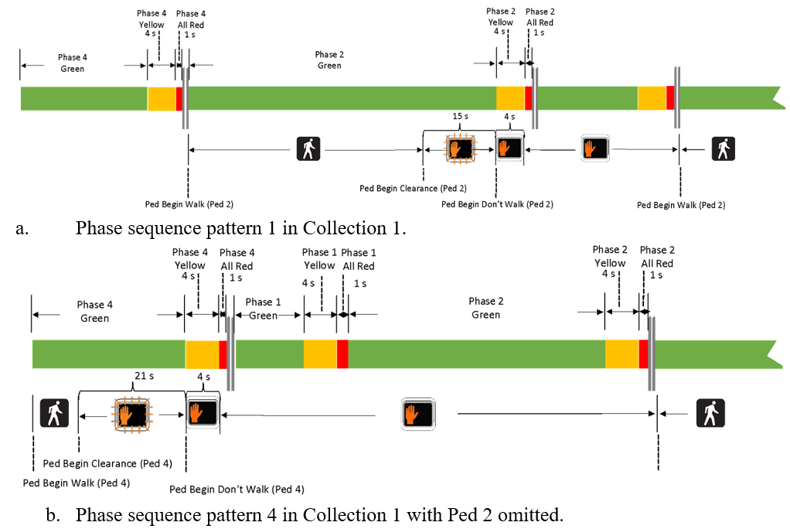
Signal Performance Log (SPM) Analysis
Pedestrian Clearance Time
Phase 2 – 15 seconds
Phase 4 – 21 seconds

Slide 8
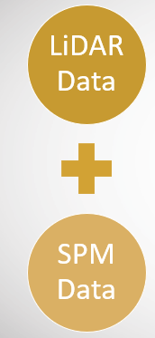
Data Integration and Preparation (Collection 1)
Secondary Filtering
Average, median speed
Maximum and average confidence
Number of detection instances (number of rows available for one ID)
Percentage of time the user was in tracking status = 3
Labeling
Initial and final box position
Duration in the system (end time - start time)
Engineering judgement
Initial Filtering
(N = 3774 users)
Clustering
N = 405 users
Eliminating cars based on confidence of detection (Label = 1 & Confidence > 0.75)
Instances observed (> 1)
Minibatch Kmeans
BIRCH

Slide 9
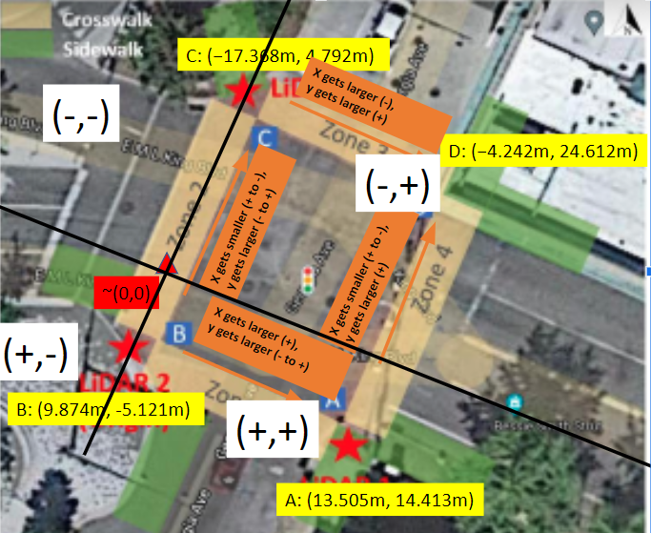
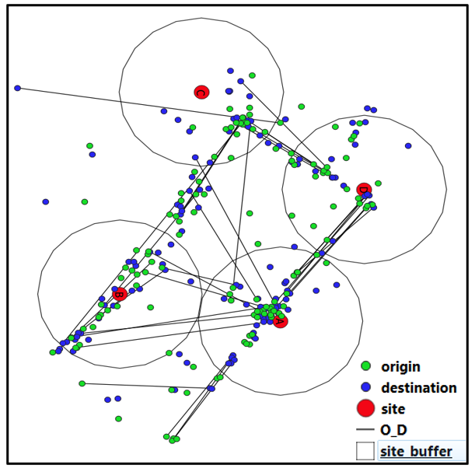
Location Matching
Reference Point Based
GIS Based

Slide 10
Pedestrian Categories (BIRCH Clustering)
Dimensions
Speed
Duration in the system
Category | Duration (seconds) | Median Velocity | Length (m) | Width (m) | Height (m)
Group 1 | 12.06 | 1.34 m/s | 0.71 | 0.81 | 1.57
Group 2 | 30.01 | 0.92 m/s | 0.72 | 0.70 | 1.62
Group 3 | 66.2 | 0.12 m/s | 0.78 | 0.82 | 1.78

Slide 11
Signal Timing Modifications
Georgia Ave (Segment AB and CD, Phase 2)
Group 1 – No addition
Group 2 – No addition
Group 3 – Faulty detections?
MLK Blvd (Segment BC and AD, Phase 4)
Group 1 – No addition
Group 2 – 2 seconds
Group 3 – 4 seconds
Need of addressing not just signal timing – Pedestrian congestion at Corner B

Slide 12
Conclusions
Machine learning based clustering could differentiate categories of pedestrians. Location matching provided further insights
Changes in pedestrian timings recommended. However, we must consider certain geometrical improvements as well.
Pedestrian categorization is required since the speeds varies
1
2
3

Slide 13

Comments or Questions?
Contact Information:
1. Sruthi Ashraf
2. Xiaoyu ”Sky” Guo
Zachry Department of Civil & Environmental Engineering
Texas A&M University

